Slide 1
RESEARCH PROJECT REPORT IN FULFILMENT OF SUMMER INTERNSHIP PROJECT
TOPIC:
CONSTITUTION
SUBMITTED BY: SUBMITTED TO:
Saniya Usmani Shashwat Singhal

Slide 2
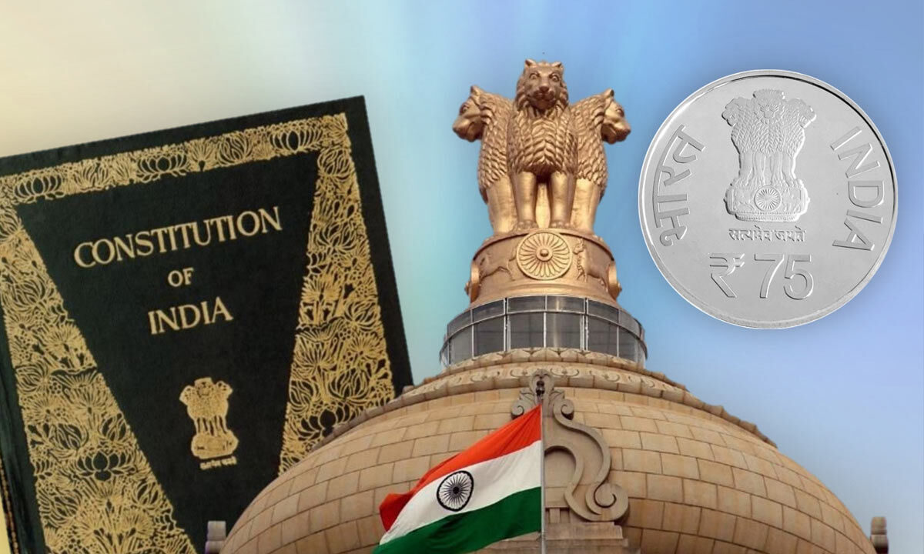
What is a Constitution?
A constitution is the supreme law of a country.
It defines the powers and duties of the government.
It protects the rights of citizens.
It provides a framework for governance.

Slide 3
Making of the Constitution
Constituent Assembly
Formed in 1946.
Consisted of 299 members.
Worked for nearly 3 years.
Adopted on 26 November 1949.
Came into effect on 26 January 1950.

Slide 4
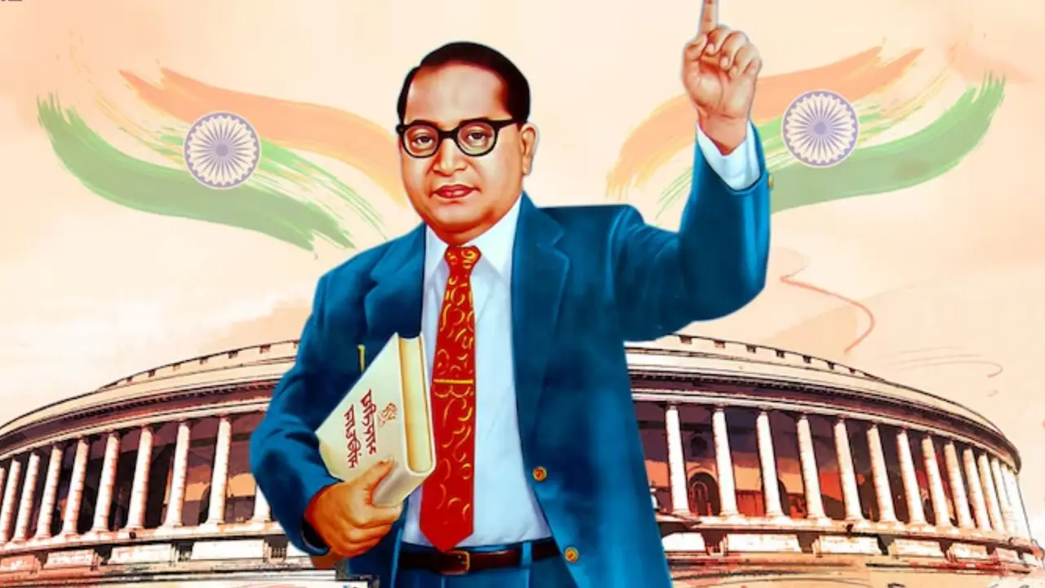
Dr. B. R. Ambedkar
Father of the Indian Constitution
Chairman of the Drafting Committee.
Played a key role in framing the Constitution.
Advocated equality, justice, and fundamental rights.
His contributions are remembered nationwide.

Slide 5
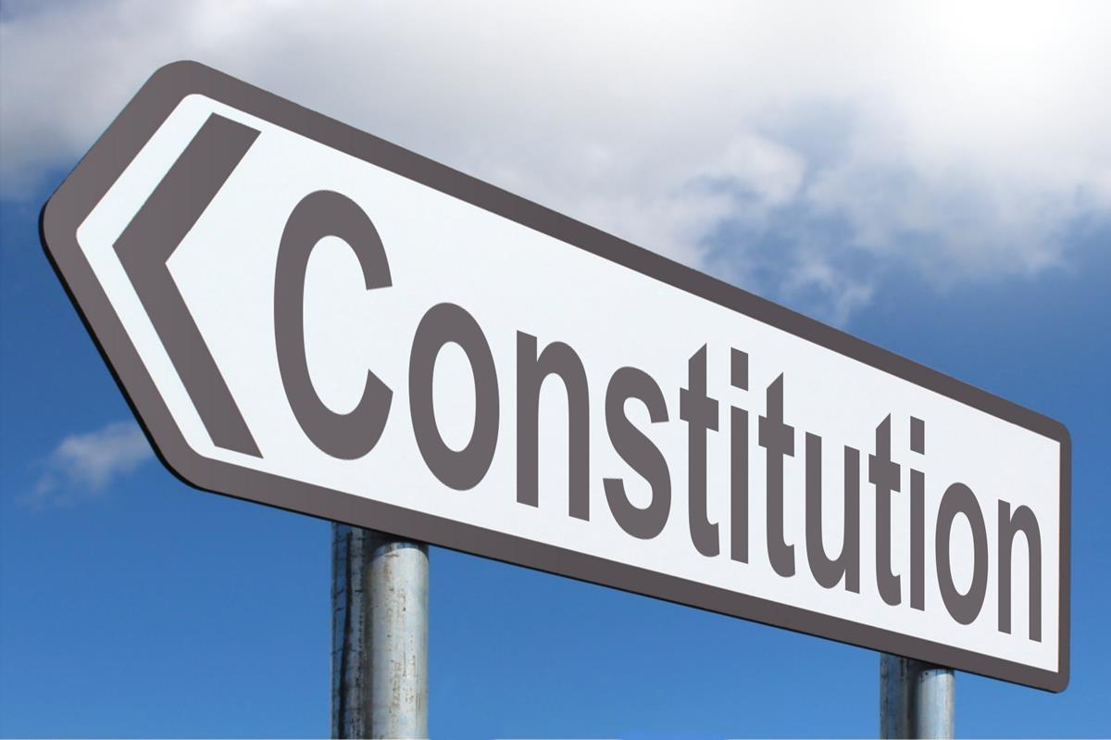
Features of the Indian Constitution
Key Features:
Written and detailed Constitution.
Parliamentary system of government.
Federal system with a strong center.
Independent judiciary.
Secular and democratic nation.

Slide 6
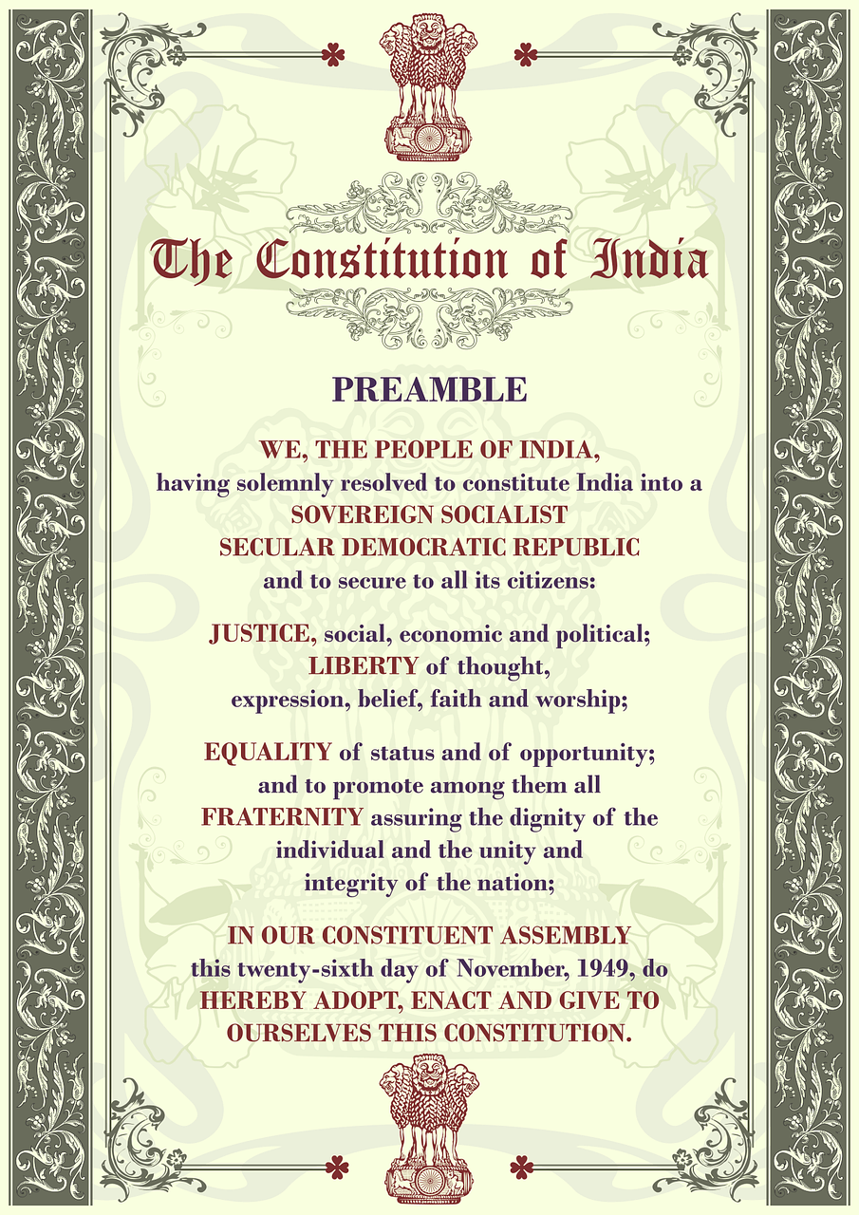
Preamble
The Preamble declares India to be:
Sovereign
Socialist
Secular
Democratic
Republic
It aims to secure:
Justice
Liberty
Equality
Fraternity

Slide 7
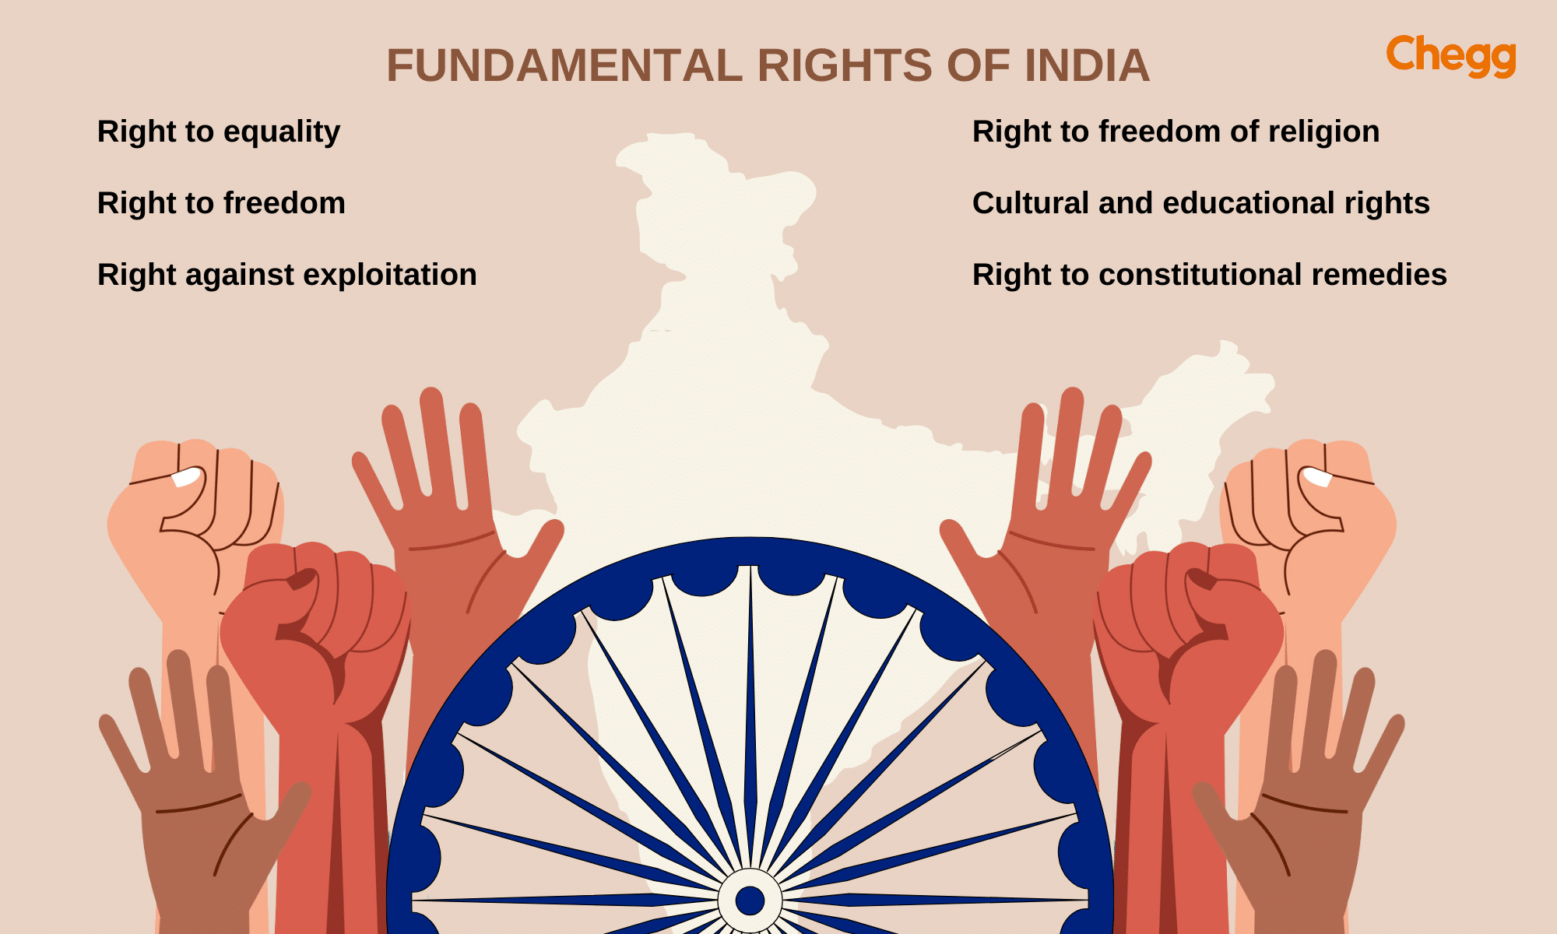
Fundamental Rights
Rights of Citizens
Right to Equality
Right to Freedom
Right against Exploitation
Right to Freedom of Religion
Cultural and Educational Rights
Right to Constitutional Remedies

Slide 8

Fundamental Duties
Duties of Citizens
Respect the Constitution.
Protect national unity.
Safeguard public property.
Promote harmony and brotherhood.
Protect the environment.

Slide 9
Directive Principles of State Policy
Guidelines for Government
Promote social and economic welfare.
Reduce inequalities.
Improve public health.
Provide education and justice.
Establish a welfare state.
These principles are not legally enforceable but guide government policies.

Slide 10
Conclusion
Importance of the Constitution
Ensures democracy and rule of law.
Protects citizens' rights.
Maintains unity in diversity.
Guides the functioning of the nation.
Acts as the foundation of modern India.

Slide 11


